Slide 1

GIT Training

Slide 2
Agenda
What is GIT
Why GIT is useful
Downloads
What is cloning and how to do it
Branching Strategy
Master
How To create a Branch
Checkout Branch
Commit and Push
Pull and rebase
GIT fetch and Prune
How to pull the latest updates on the master branch
Access Your local Repo
How to commit
Commit Msgs. guidelines

Slide 3
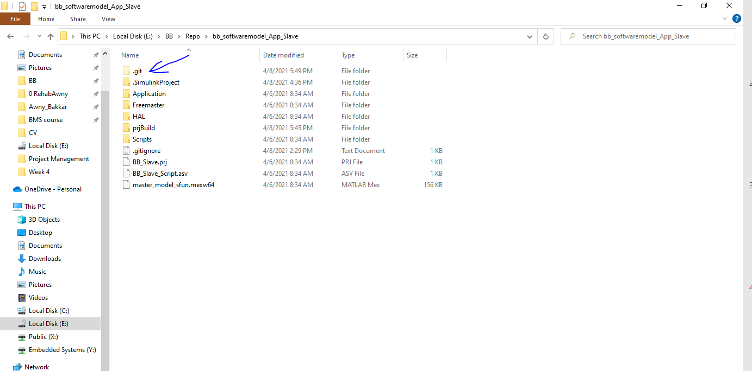
What is GIT
A Git repository is the .git/ folder inside a project.
This repository tracks all changes made to files in your project, building a history over time.
Meaning, if you delete the .git/ folder, then you delete your project’s history.

Slide 4
Why GIT is useful
GIT allows a team of people to work together , all using the same files
It helps the team cope without any confusion which usually occurs when multiple people are editing the same files

Slide 5

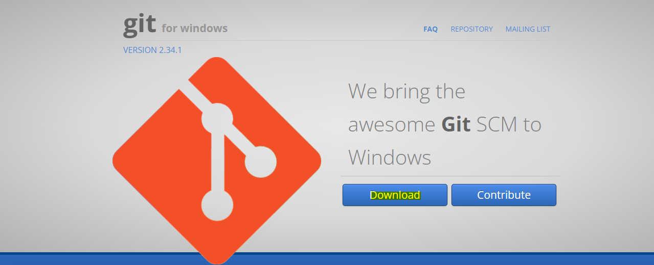
Downloads
https://gitforwindows.org/
https://sourceforge.net/projects/gitextensions/

Slide 6
What is cloning and how to do it
Cloning is a process of creating a typical copy of the file on the cloud locally on you machine (PC)
By that way you can edit freely in this file without affecting the original source files

Slide 7
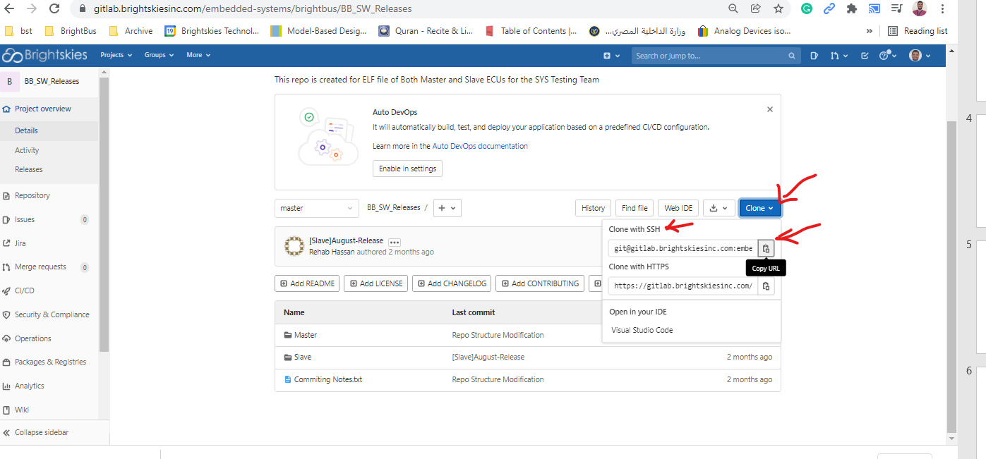
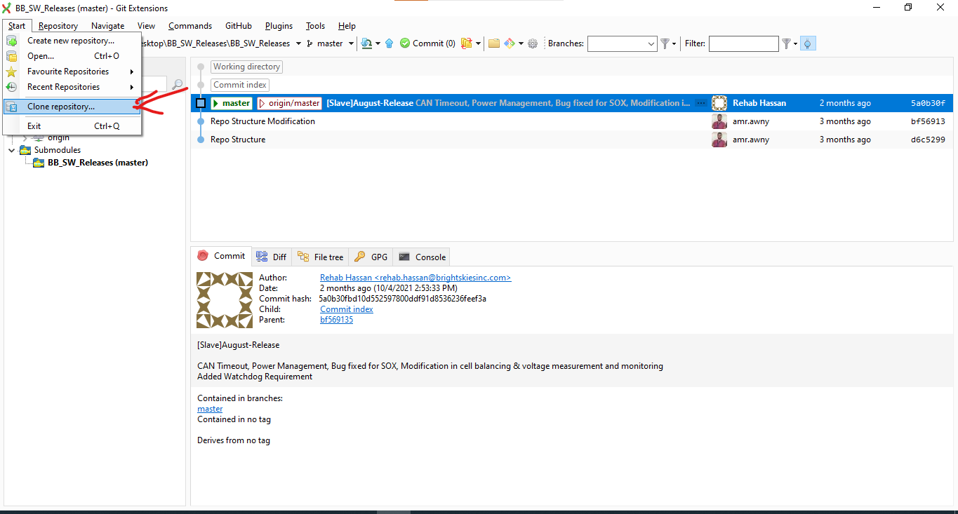
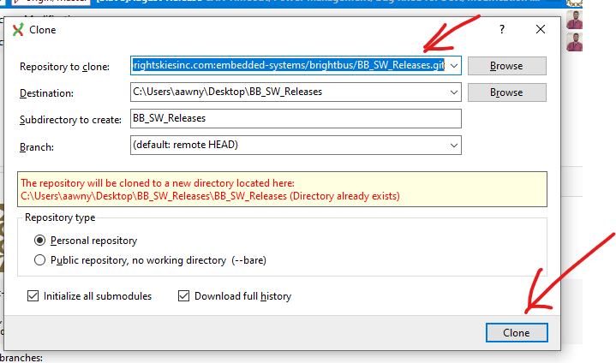
What is cloning and how to do it
To do that in an easy way
1
Go to the desired repo on
Gitlab.brightskiesinc.com and copy the SSH key
2
From GIT extensions
File > Clone
3
Paste the SSH key and choose the destination folder

Slide 8

Branching Strategy [Master Branch]

Slide 9
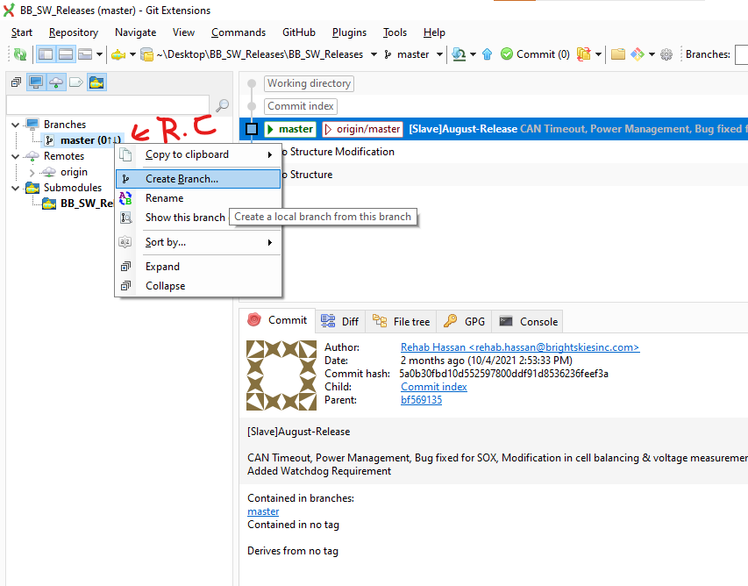
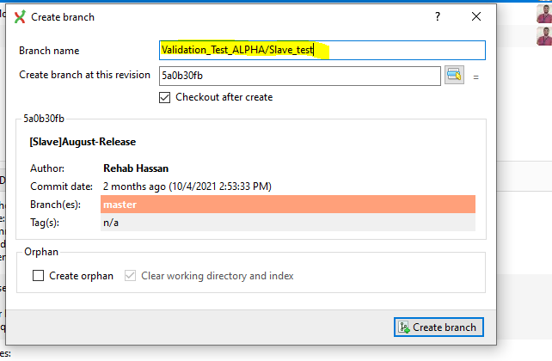
Branching Strategy [How To create a Branch]
Naming Convention
Writing / creates a new folder in the repo
Accordingly we will create a folder per release named
Validation_Test_[Release name]
Then create a branch per each ECU and Sys
/Slave_test
/Master_test
/BMS_test

Slide 10
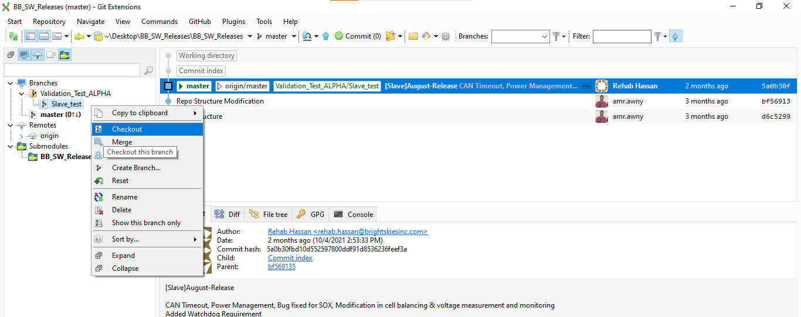
Branching Strategy [Checkout Branch]
Now we created a branch
We need to work on our local Repo
So we check out on the desired branch

Slide 11
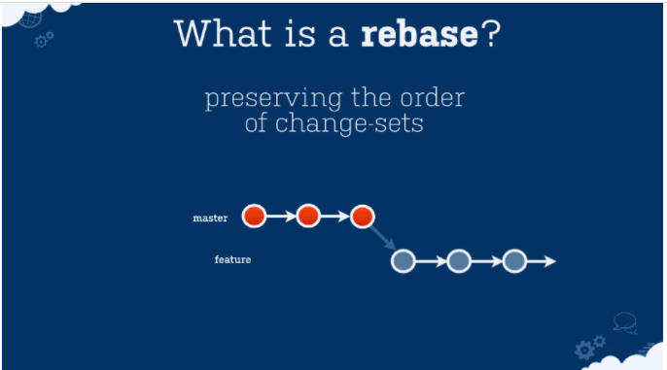
Branching Strategy [Rebase]
Rebasing is done to put the desired branch on the latest updates on the master branch

Slide 12
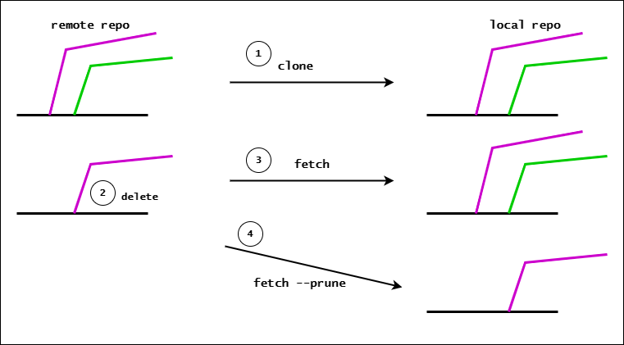
Branching Strategy [GIT fetch and Prune]
git fetch --prune is the best utility for cleaning outdated branches. It will connect to a shared remote repository remote and fetch all remote branch refs. It will then delete remote refs that are no longer in use on the remote repository.

Slide 13
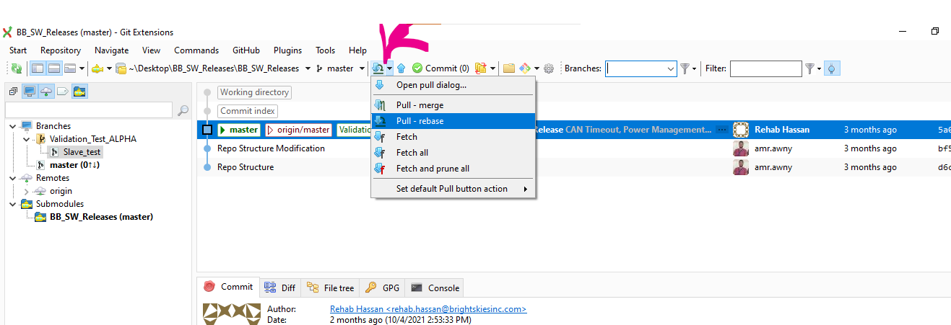
How to pull the latest updates on the master branch

Slide 14
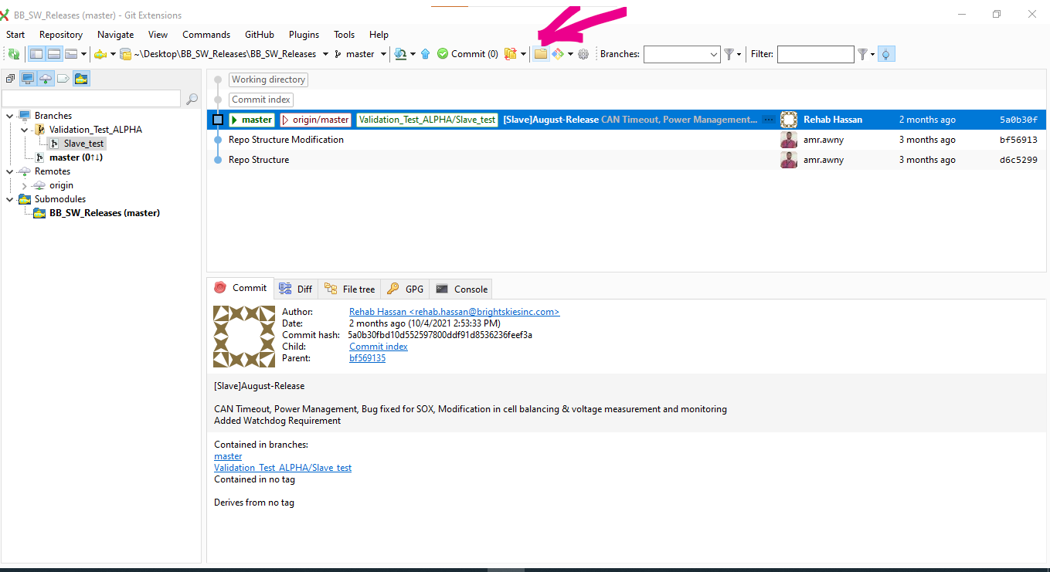
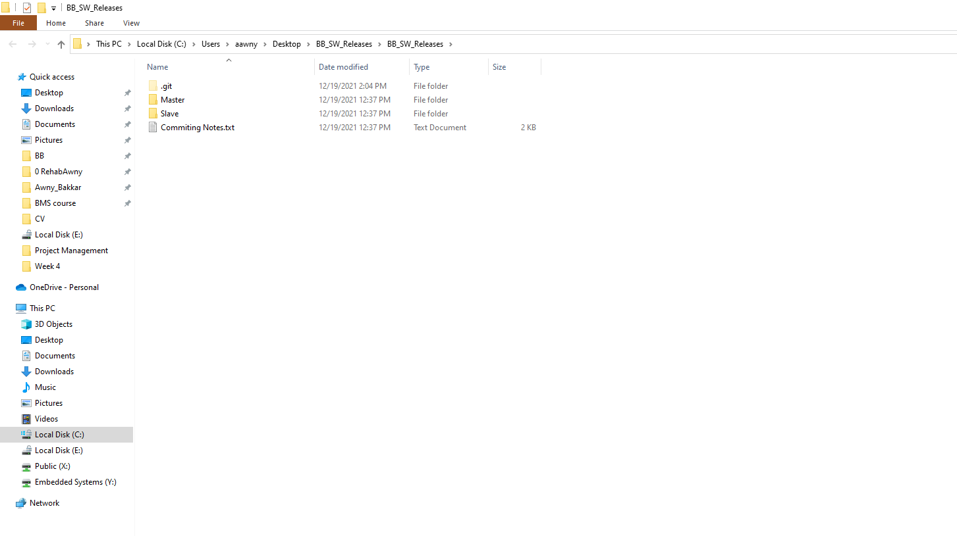
Access Your local Repo
The Repo Folder structure is organized and created by the master branch owner
Note: It is not allowed for an branch owner to change the folder structure , If you have any
Change proposal get back to the Master branch owner
Do you changes in the desired folder/file

Slide 15
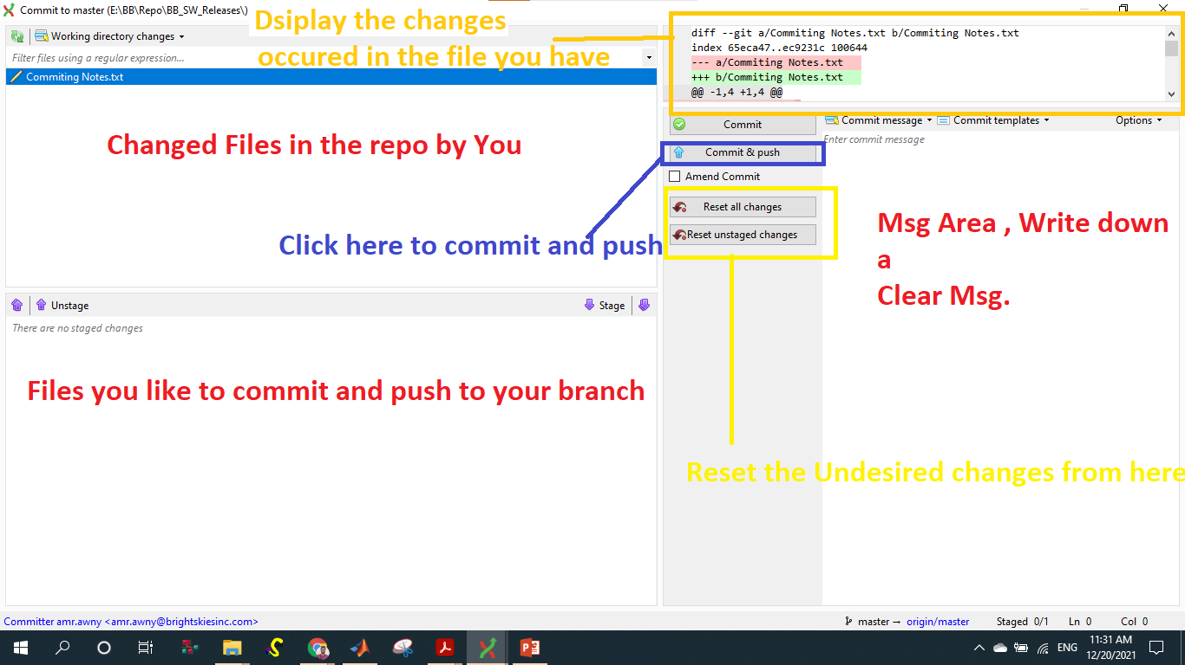
How to commit

Slide 16
How to commit [Commit Msgs guidelines]
The most important part of a commit message is that it should be clear and meaningful.
In the long run, writing good commit messages shows how much of a collaborator you are.
The benefits of writing good commit messages are not only limited to your team but indeed expand to yourself and future contributors.

